Slide 1
Assortivity STI CoInfection Status Example

Slide 2
Form Relationships Based On STI CoInfection Flag Status
Goal: See how the impact of forming relationships based on the individuals STI co-infection flag status affects the spread of the disease.
Expect: Forming relationships with like status should reduce the spread of HIV, but not the same as knowing HIV status (testing or physical)
Use Individual Property to create two Risk groups: High & Low (50%, 50%)
100% of High Risk get STI Co-Infection
50% of High Risk get HIV
No Interventions except Outbreaks!!!
Initial Population = 175,000
Overridden from Defaults
"Report_Relationship_Start" : 1,
"PFA_Cum_Prob_Selection_Threshold": 0.2,
"PFA_Update_Period_Transitory" : 30,
"PFA_Update_Period_Informal" : 30,
"PFA_Update_Period_Marital" : 30

Slide 3
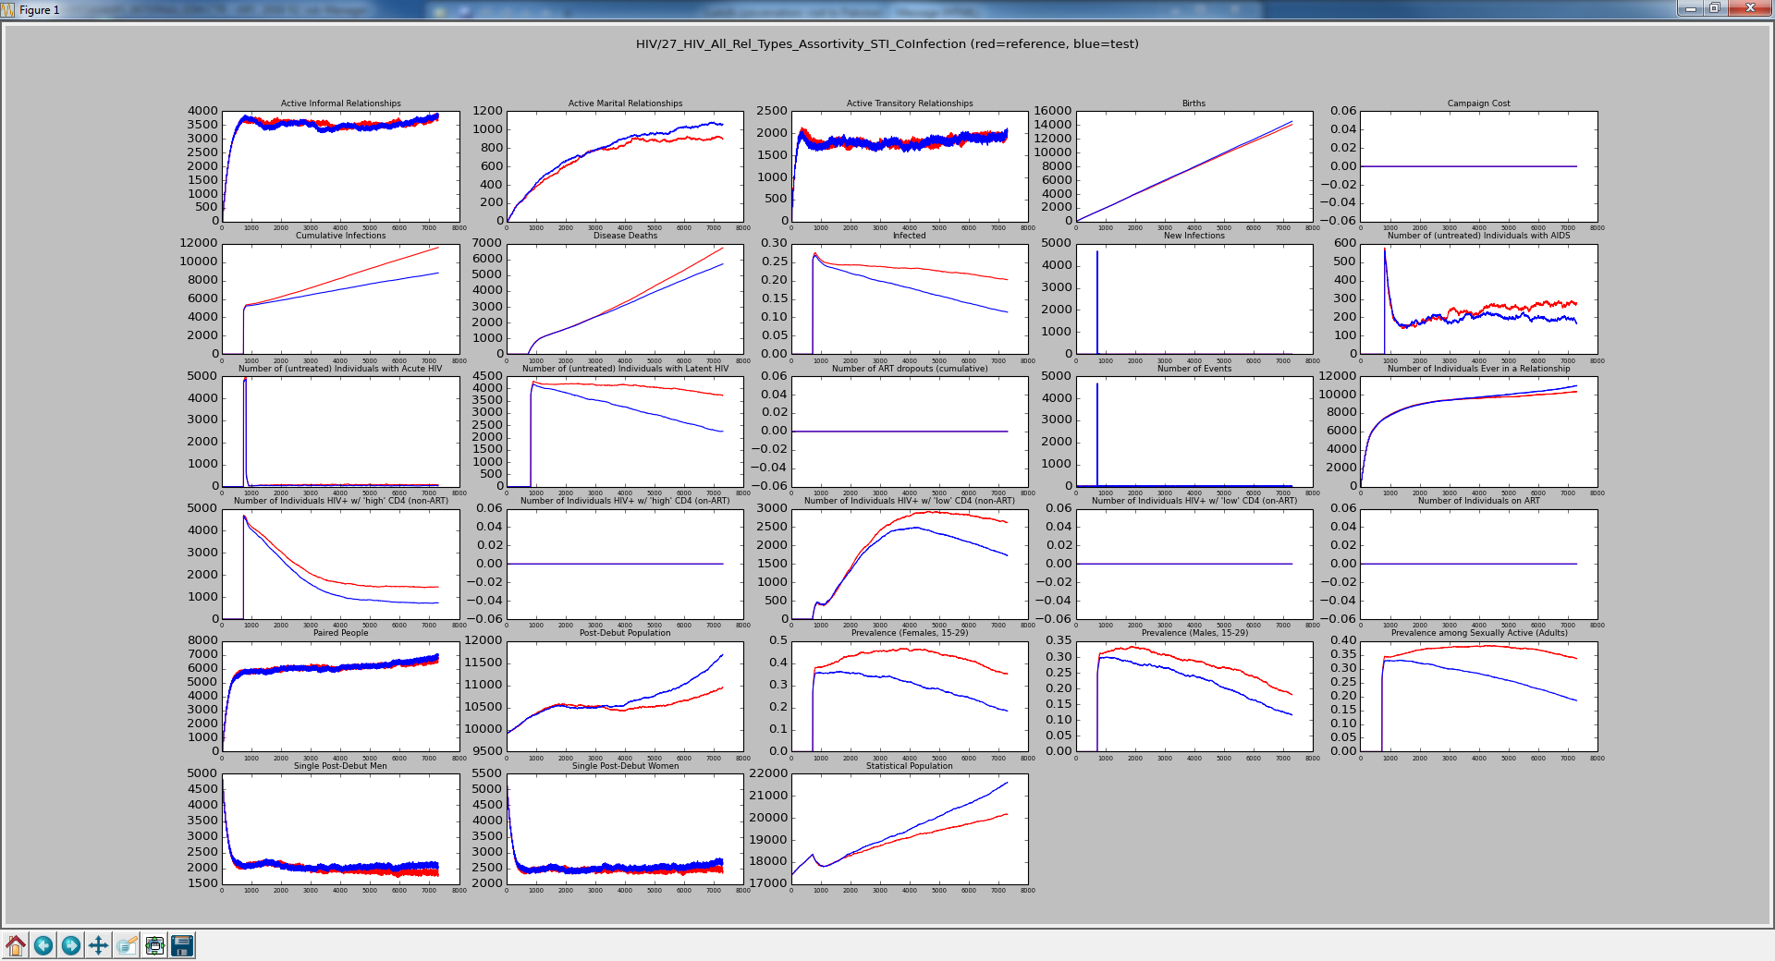
Red is All Types with No Groups Blue is All Types with Matrix
[1.0, 0.0],
[0.0, 1.0]
Getting maximum reduction in infection.

Slide 4
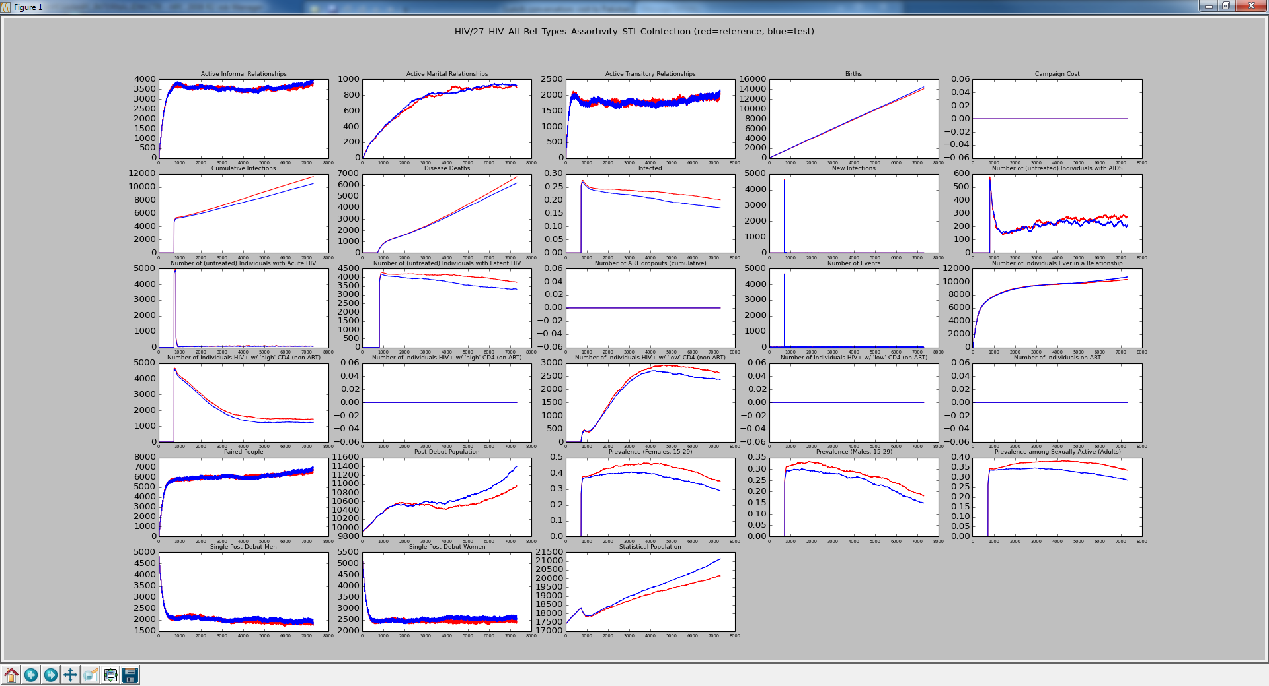
Red is All Types with No Groups Blue is All Types with Matrix
Allowing some mixed relationships greatly increases the spread of the disease. This seems a little more than I’d like, but I think we would need to have more of the population infected with HIV .
[0.9, 0.1],
[0.1, 0.9]

Slide 5
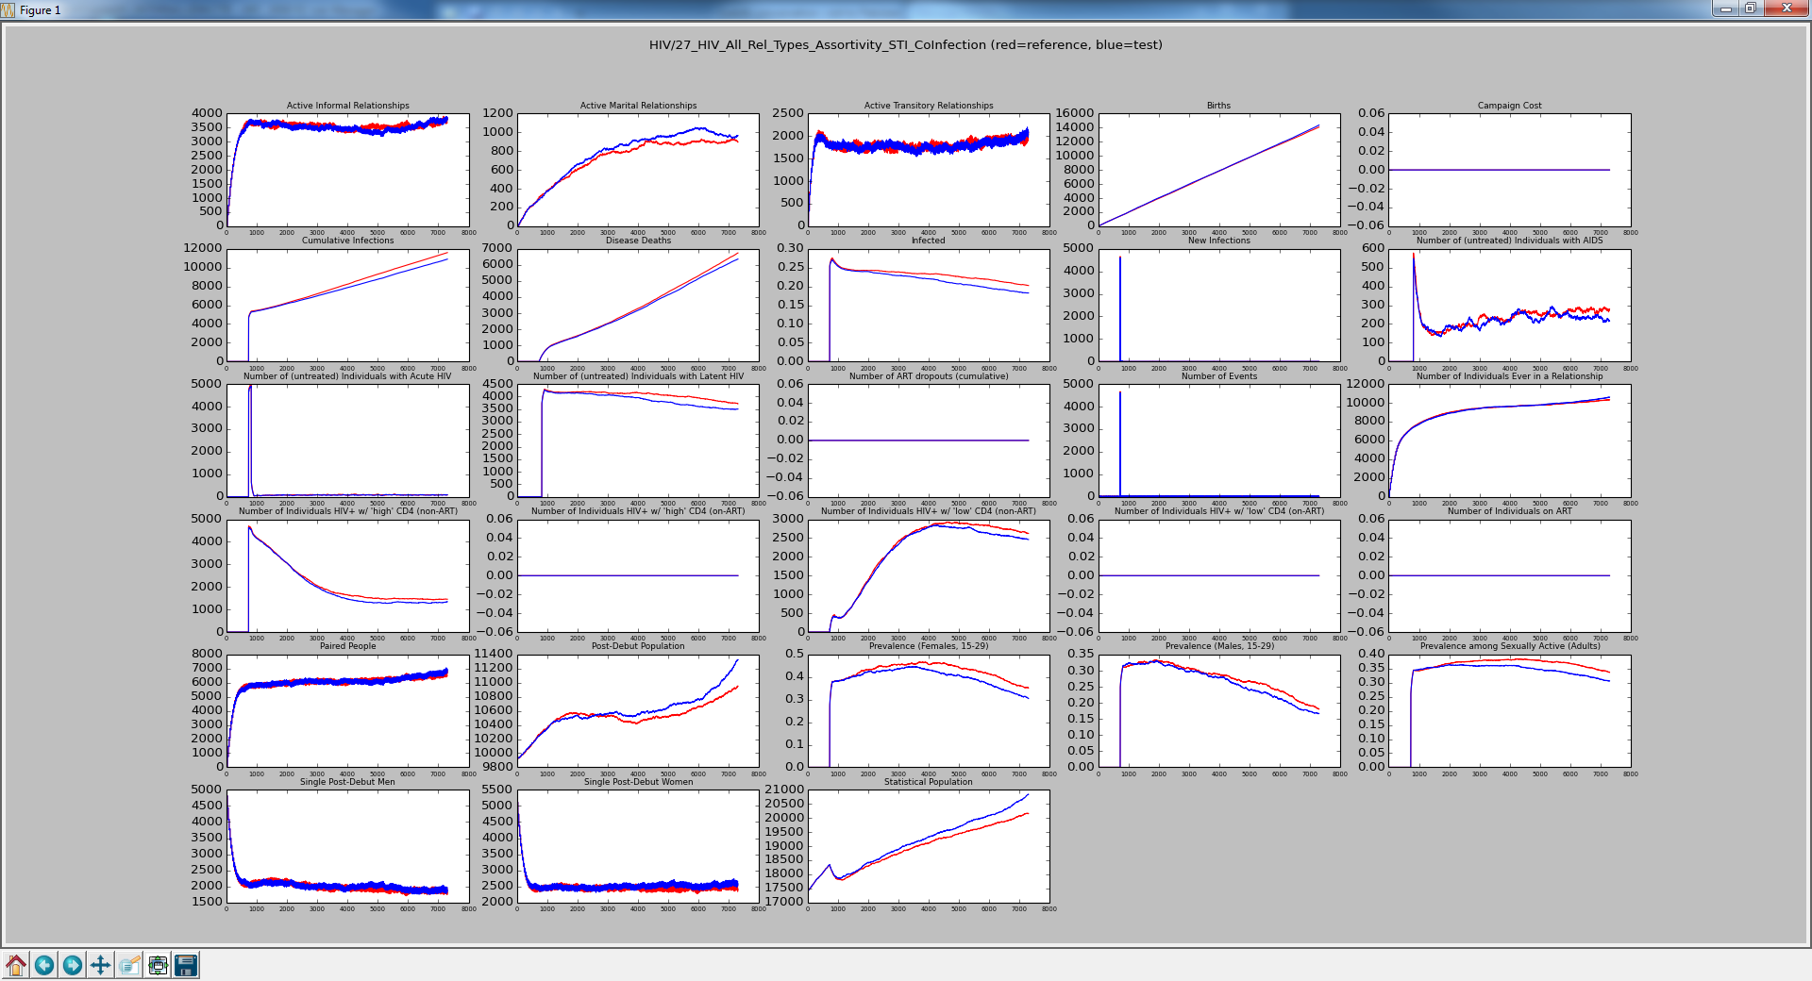
Red is All Types with No Groups Blue is All Types with Matrix
Increasing the mixed infection status relationships causes increased infection, but still not a small concern on sensitivity.
[0.8, 0.2],
[0.2, 0.8]

Slide 6
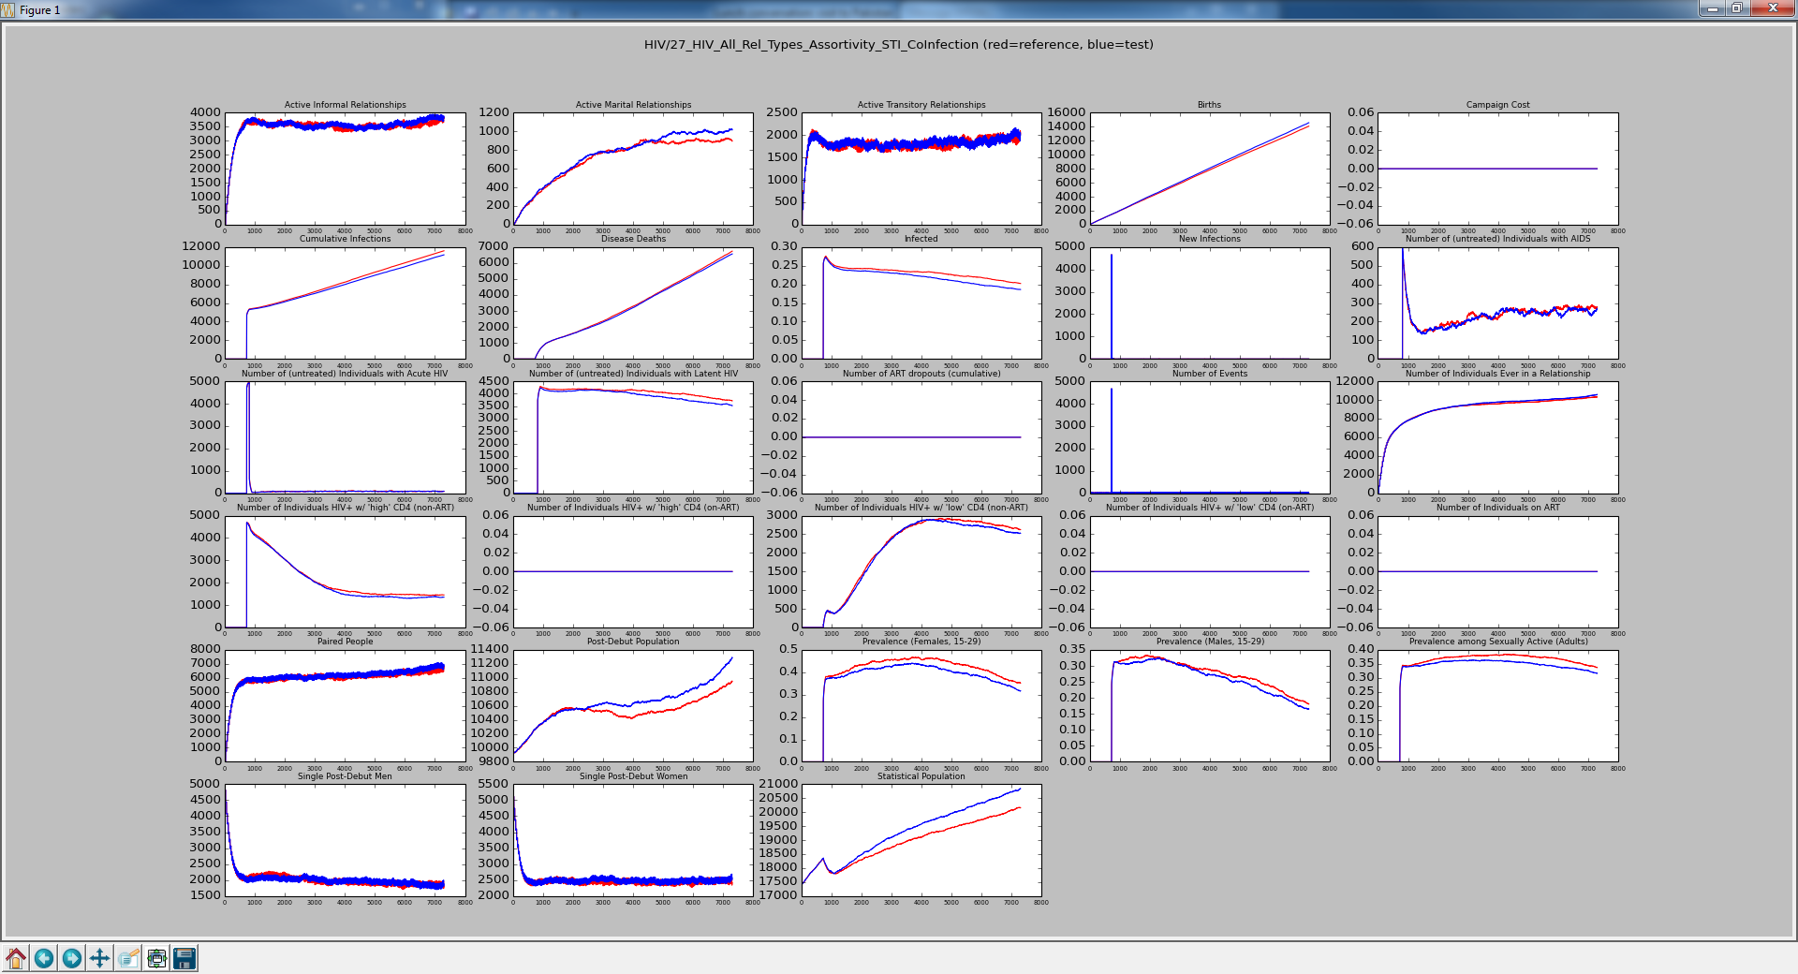
Red is All Types with No Groups Blue is All Types with Matrix
[0.7, 0.3],
[0.3, 0.7]
???

Slide 7
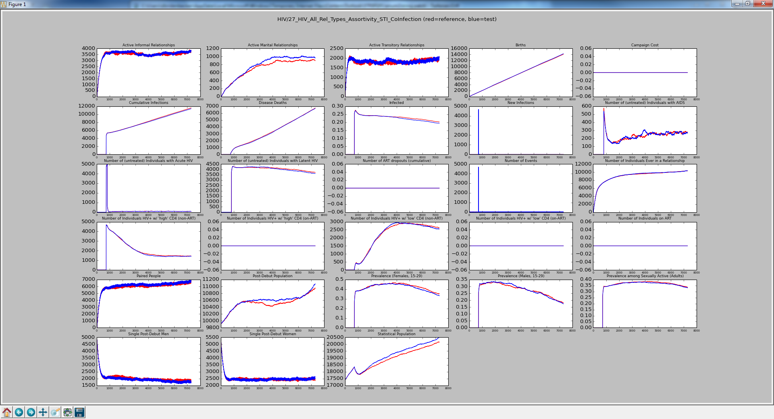
Red is All Types with No Groups Blue is All Types with Matrix
[0.5, 0.5],
[0.5, 0.5]
Back to the same as NO_GROUPS

Slide 8
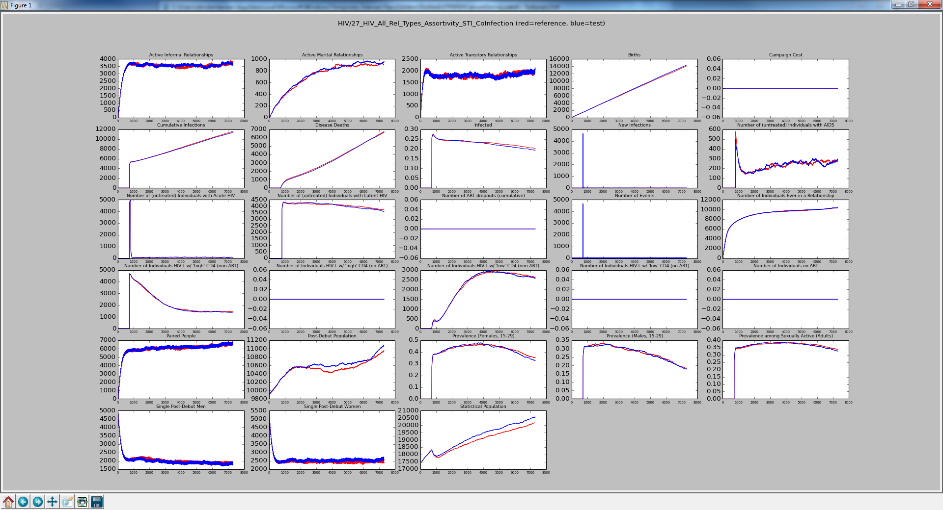
Red is All Types with No Groups Blue is All Types with Matrix
[0.25, 0.75],
[0.75, 0.25]
???

Slide 9
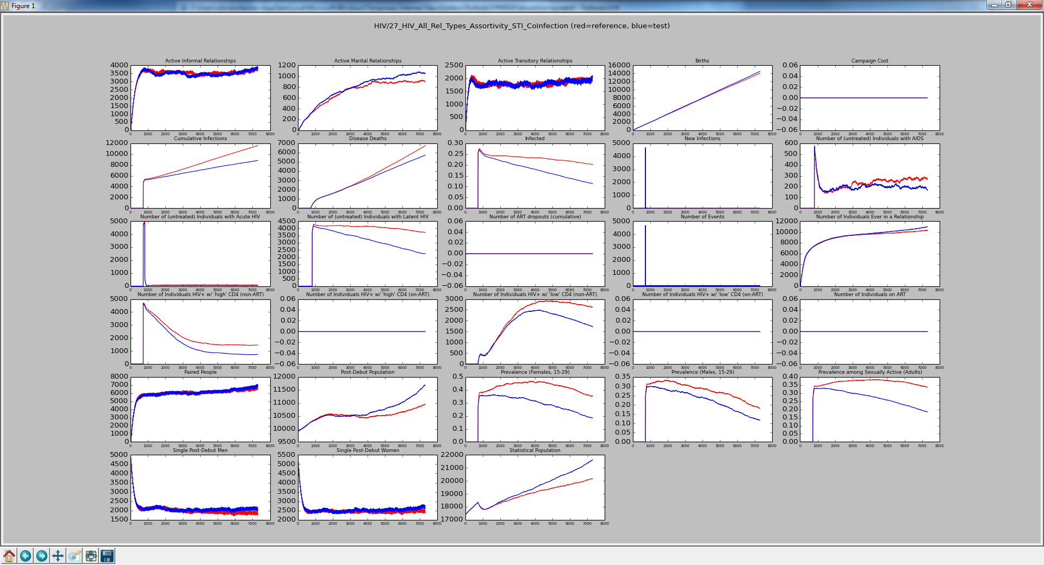
Red is All Types with No Groups Blue is All Types with Matrix
???
[0.0, 1.0],
[1.0, 0.0]

Slide 10
Test Update
Reduced simulation duration to reduce runtime

Slide 11
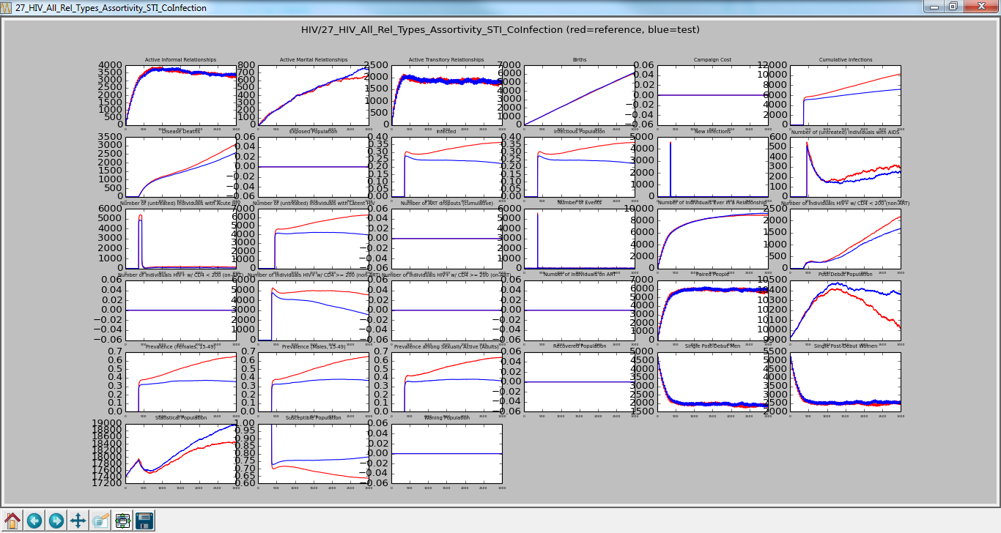
Red is All Types with No Groups Blue is All Types with Matrix
[0.0, 1.0],
[1.0, 0.0]
Simulation_Duration : 3000
Cutting simulation time from 7300 to 3000 reduces runtime from > 5 minutes to less than 2.5 minutes

Slide 12

Red is All Types with No Groups Blue is All Types with Matrix
[0.9, 0.1],
[0.1, 0.9]
Simulation_Duration : 3000
Checked-In

